Slide 1


Image Super-Resolution
Digital Signal and Image Management Project
University of Milano-Bicocca
Matteo Breganni 869549
Francesco Cavallini 920835

Slide 2
Dataset
Preparation

Slide 3
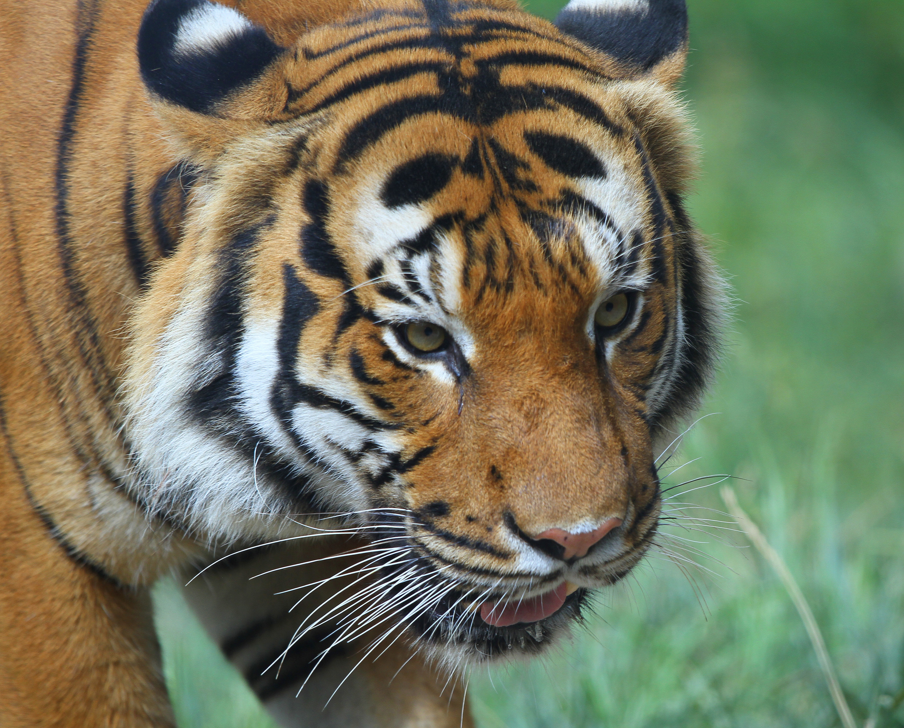
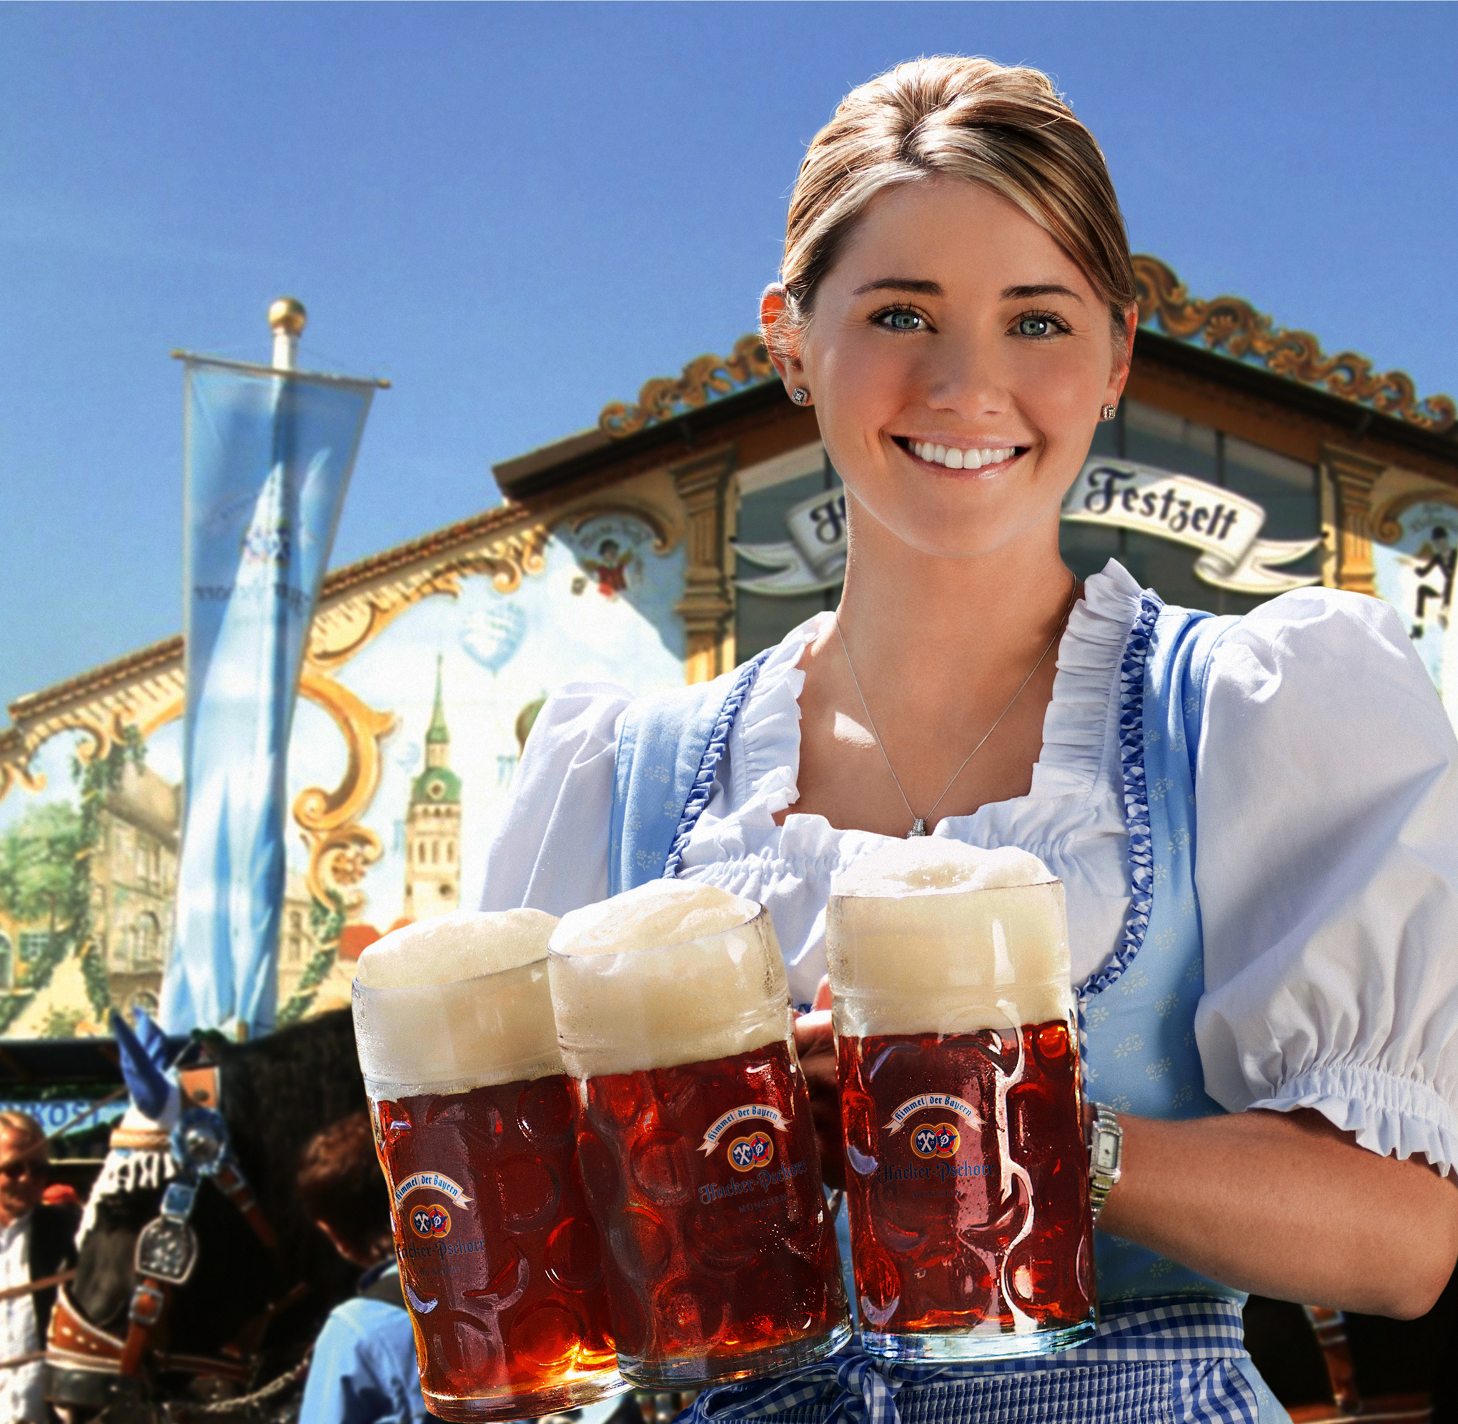
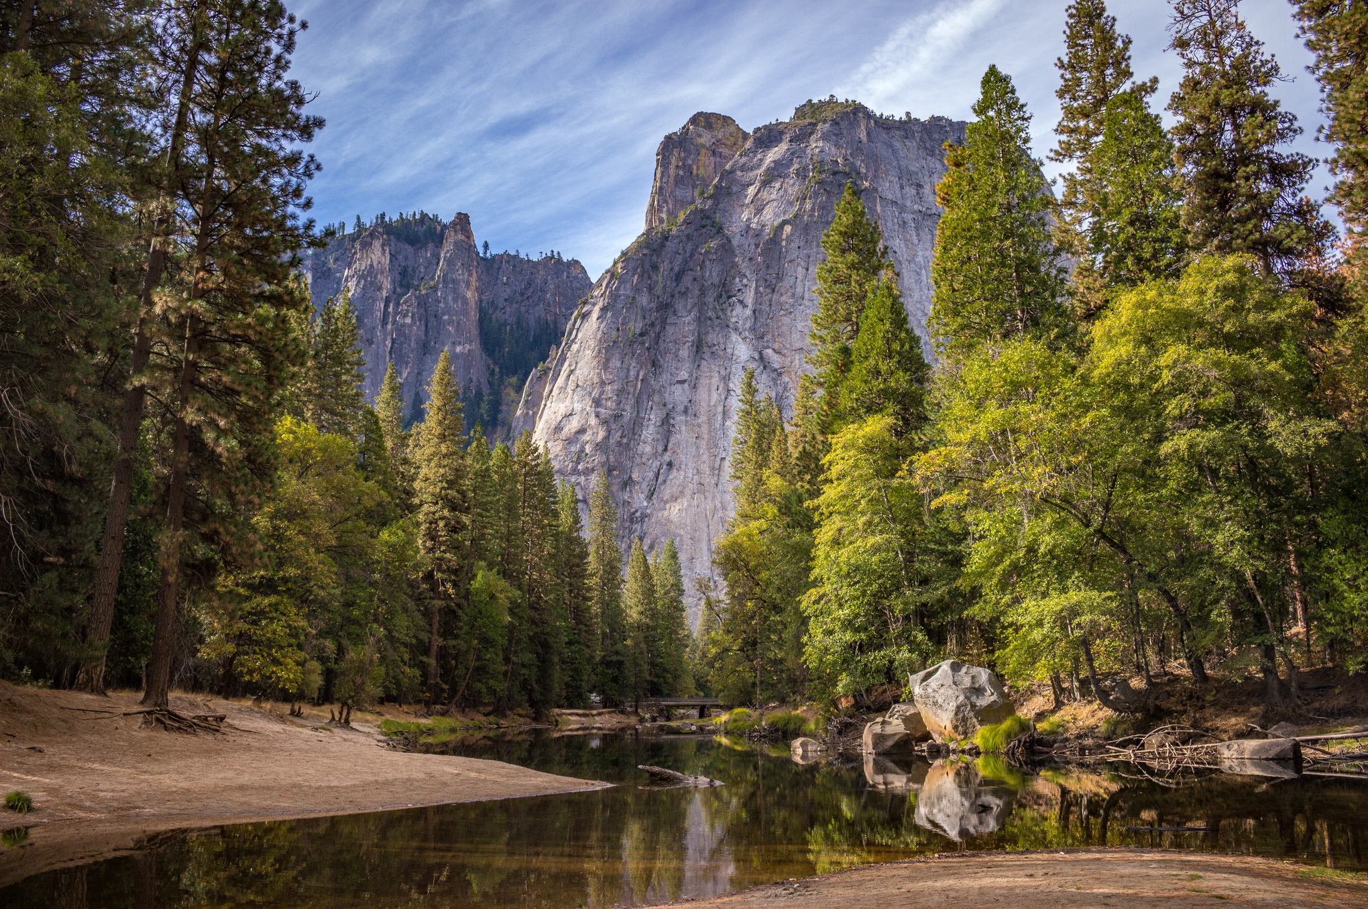
Manually created dataset
Used at the beginning of the project
General dataset, many different types of natural images (people, animals, structures, nature…)
Training images: 100
Test images: 50

Slide 4
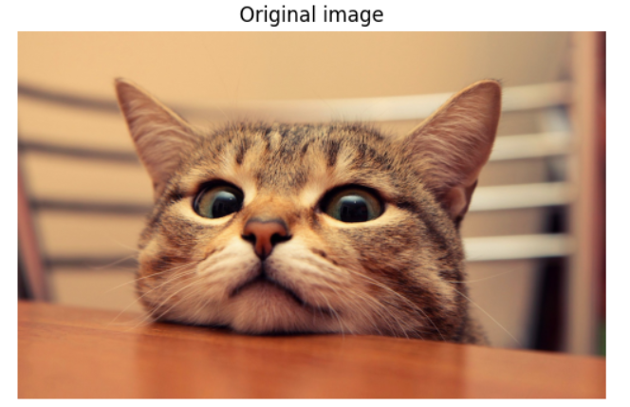
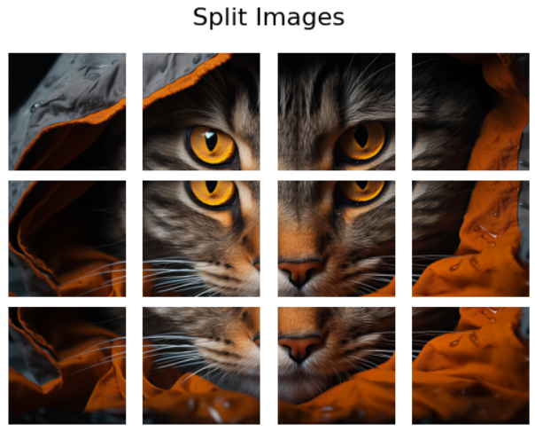
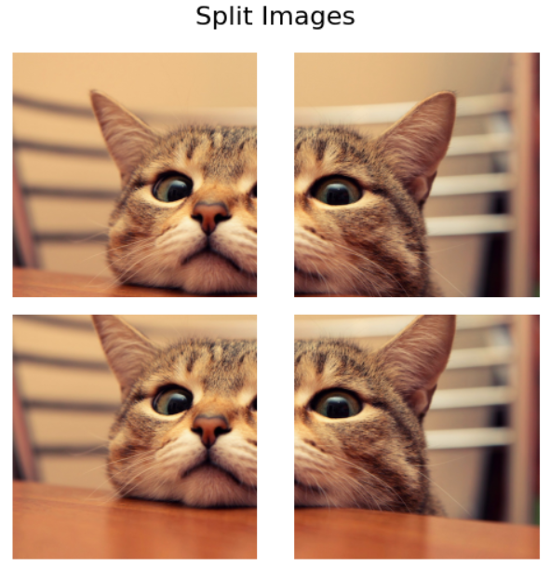
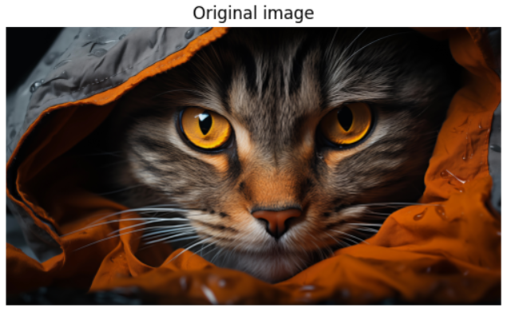
Dataset augmentation
Original images divided into 256x256 overlapping patches
80/20 train/val split applied
Training images: 80 → 3752
Validation images: 20 → 992
Test images: 50 → 2344
Images directly saved in colab’s runtime to save RAM and have fast access during training
Size: (1200, 1920, 3)
Size: (2160, 3840, 3)
Sizes: (1000, 1000, 3)
(images not part of the dataset)
Sizes: (1000, 1000, 3)

Slide 5
Super Resolution Convolutional Neural Network (SRCNN)

Slide 6
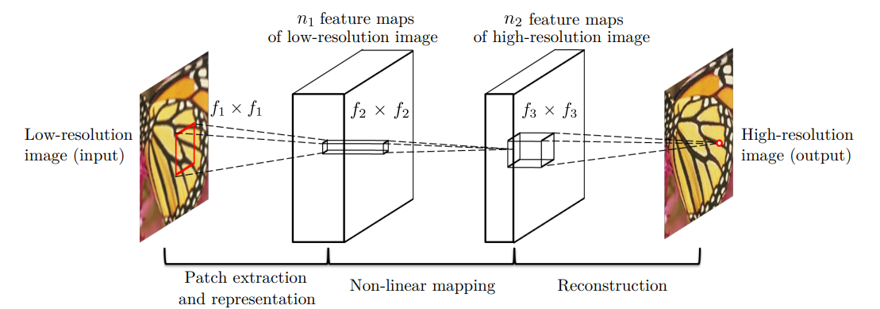
SRCNN
Based on the original 2014 paper that pioneered the use of CNNs for image super-resolution
The input is the low resolution image, upscaled by the same factor it was downscaled with, to match the output size of the original image (patch).
3 channel RGB input works better than YCbCr because of the correlation between channels
Input: 33x33x3
First layer: 64 filters 9x9 to capture the image’s features representations
Second layer: 32 filters 1x1 to learn non-linear transformations of the features
Third (and output) layer: 3 filters 5x5 to reconstruct the high-resolution image from the feature maps (output size: 33x33x3, because of padding = ‘same’)

Slide 7
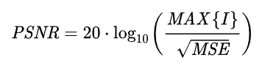
Evaluation metrics
Peak Signal-to-Noise Ratio (PSNR)
Comparing the reconstructed image to the original
A higher PSNR indicates that the SRCNN-generated image is closer to the original high-resolution image.
Also computed between the upscaled image using bicubic interpolation and the high resolution image, as a baseline.
Structural Similarity Index Measure (SSIM)
Used starting with the 4th model
Calculates the similarity between two images by comparing the luminance (how well the brightness matches between the two images), the contrast (the consistency of pixel intensity variations between the two imaegs) and the strucutral information (compares the structural arrangement of pixels, to make sure that structures and patterns, so textures and edeges, are preserved).
The closer to 1, the better.

Slide 8
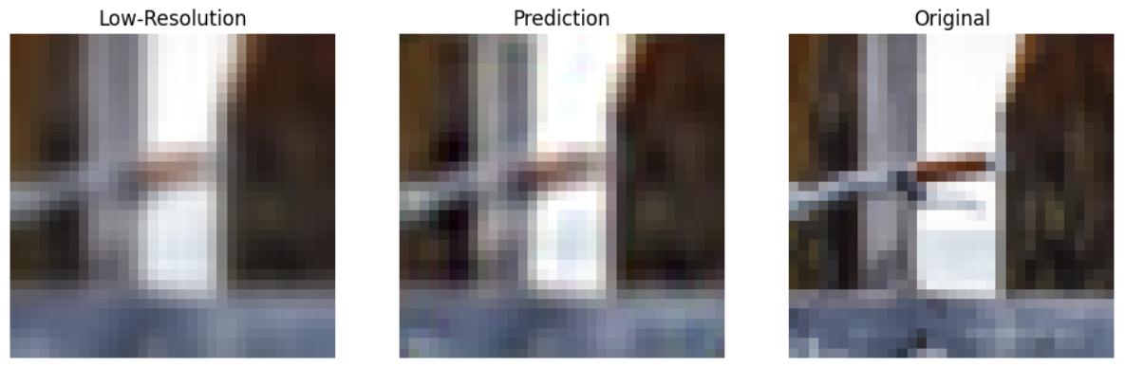
First model and issues
2x scale factor used
PSNR between LR and HR: 29.85 dB PSNR between Predicted and HR: 29.70 dB
Slight quality improvement
PSNR worse than the baseline?

Slide 9
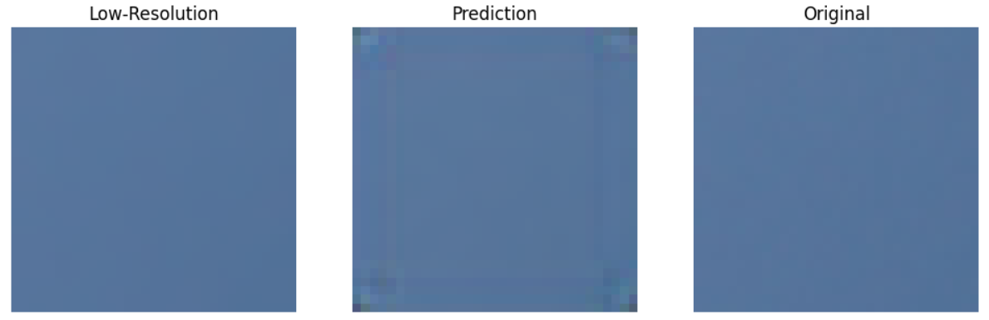
First model and issues
Padding=‘same’ and mantaining input size=output size causes issues around the edges
PSNR between LR and HR: 52.43 dB PSNR between Predicted and HR: 40.82 dB
Padding=‘same’ uses 0-padding around the edges, to mantain the spatial dimension
Introduces artifacts around edges and (especially) corners

Slide 10
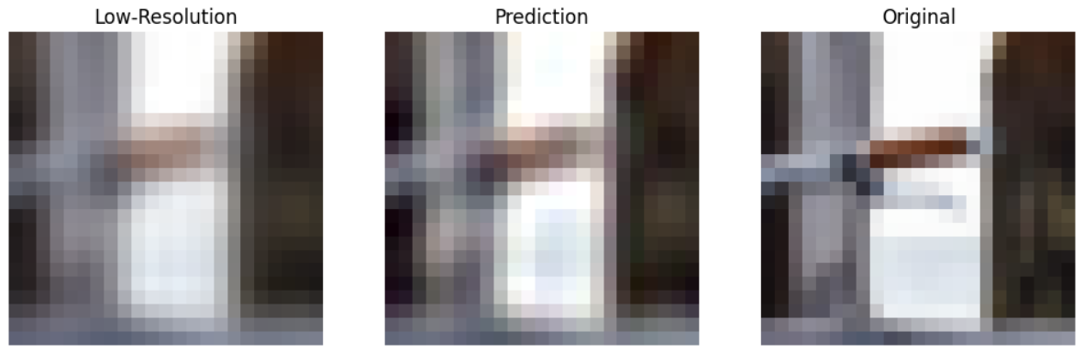
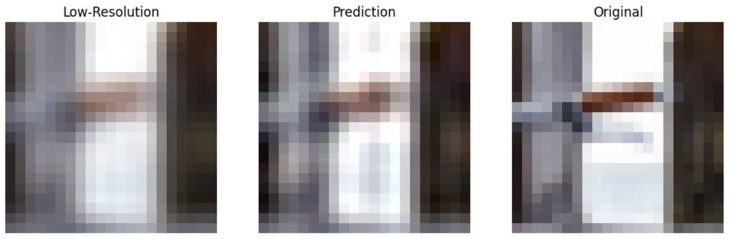
Solution 1
Cut the affected border, reducing the size of the output
PSNR between LR and HR: 28.78 dB
PSNR between Predicted and HR: 28.97 dB
Solution 2 (second model)
Use padding=‘valid’
The model will reduce the size of the output organically (from 33x33 to 21x21)
PSNR between LR and HR: 28.79 dB
PSNR between Predicted and HR: 28.96 dB
Average PSNR between low resolution images (bicubic interpolation) and high-resolution images: 38.66 dB
Average PSNR between predicted images and high-resolution images: 37.79 dB (was 34.52 dB)
Average PSNR improved but lower than the baseline, why?

Slide 11
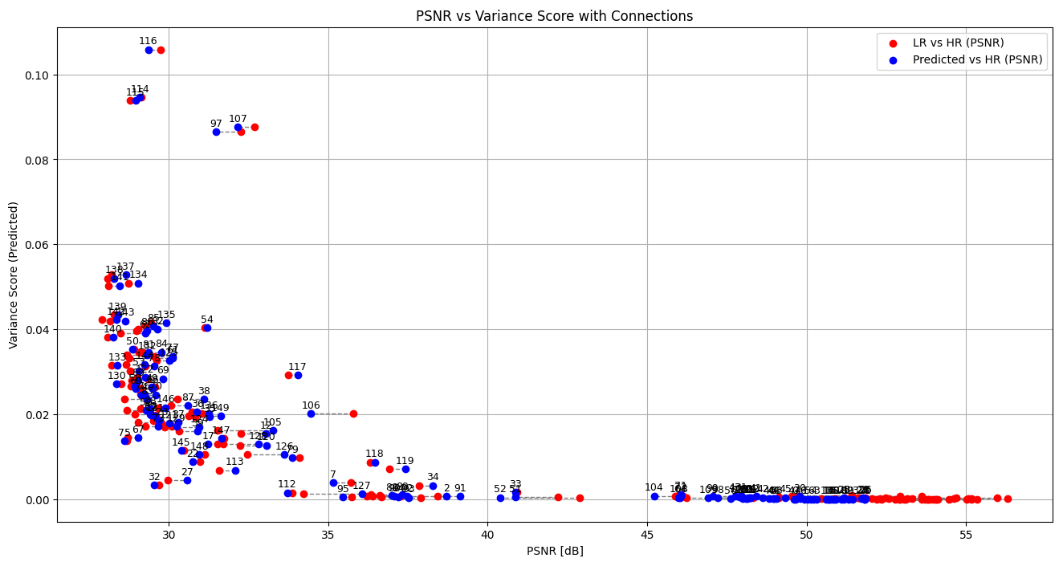
Investigation the issue
Dot plot of variance, LR vs HR PSNR and Predicted vs HR PSNR for each image

Slide 12
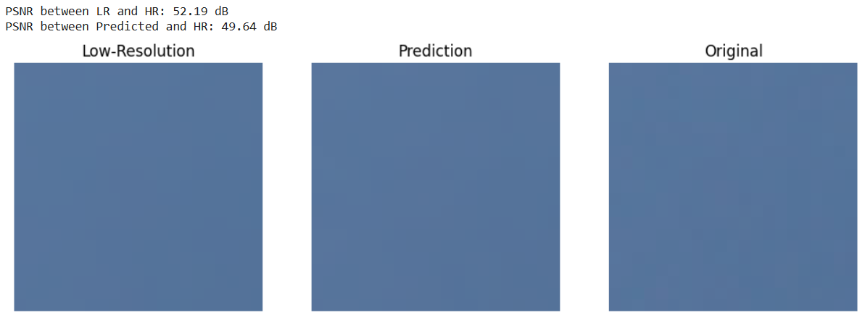
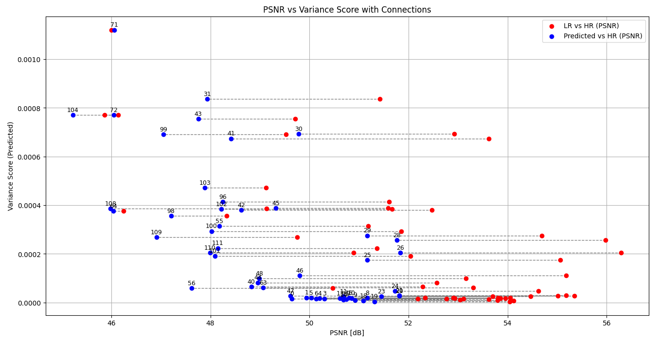
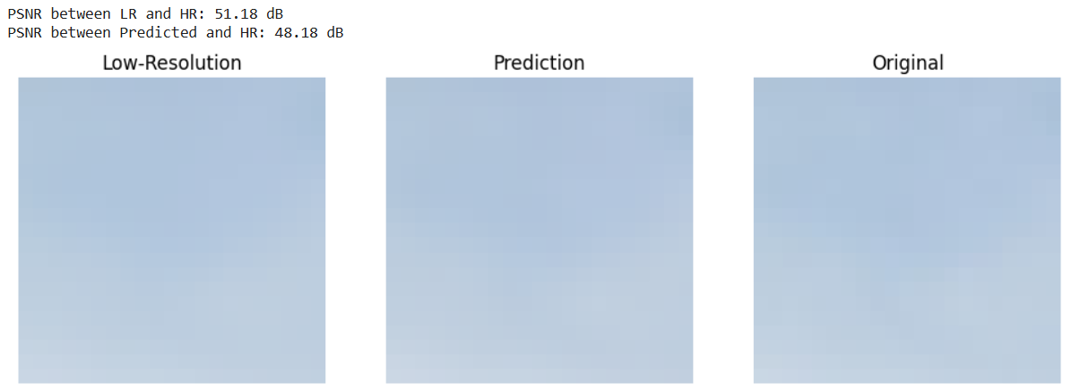
Investigation the issue
Bottom right corner of the previous plot:
Images with the highest PSNR difference from the baseline are those with high PSNR and low variance
Slight shift of color shade applied by the model
High impact on the test set average PSNR because of the high PSNR values
Excluding this category of images:
Average PSNR (LR-HR): 30.99188956352703
Average PSNR (Pred-HR): 31.51631000379358
PSNR finally improves

Slide 13
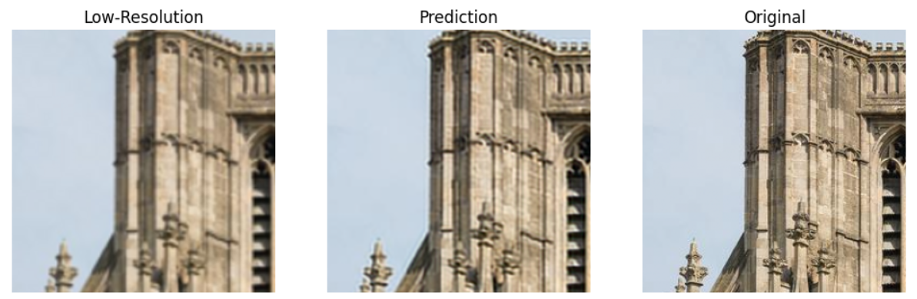
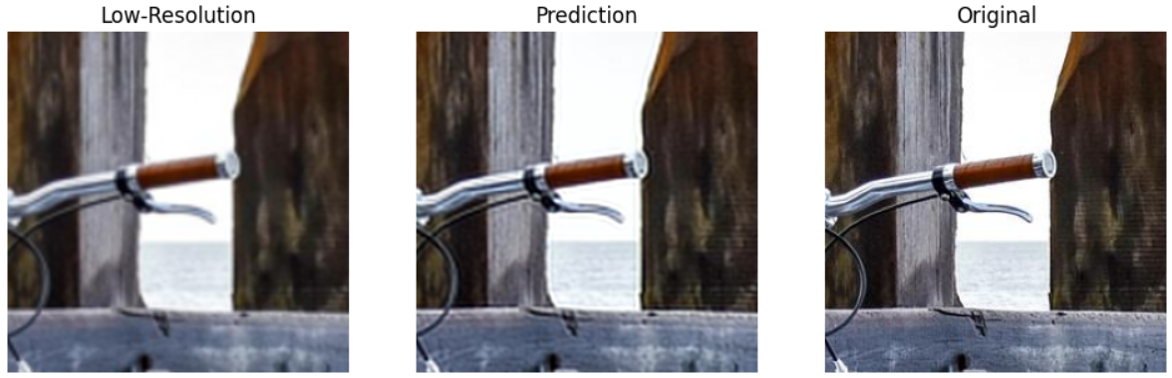
Third model
Same model architecture, but with 256x256x3 input and 244x244x3 output
PSNR between LR and HR: 31.03 dB PSNR between Predicted and HR: 31.25 dB
PSNR between LR and HR: 32.04 dB PSNR between Predicted and HR: 32.56 dB
Quality visually improved, but PSNR score doesn’t reflect it well
Average PSNR between low resolution images (bicubic interpolation) and high-resolution images: 37.92 dB
Average PSNR between predicted images and high-resolution images: 37.42 dB

Slide 14
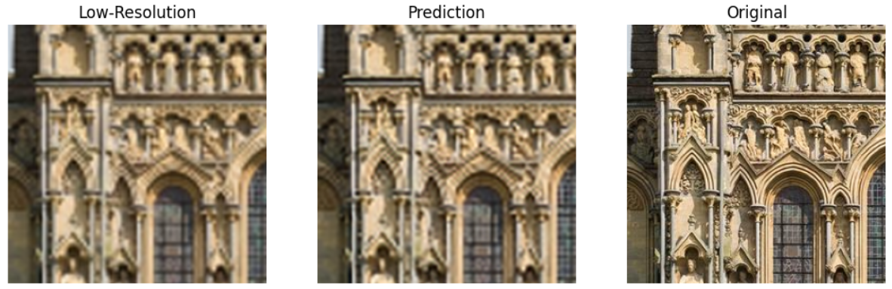
Fourth model
Same model architecture, same 256x256x3 input and 244x244x3 output, but 3x scale factor
PSNR between LR and HR: 28.54 dB PSNR between Predicted and HR: 28.56 dB
Performance visually worse, as expected
PSNR values seem to not reflect the performance drop compared to the previous model
Average PSNR between low resolution images (bicubic interpolation) and high-resolution images: 37.52 dB (was 37.92 dB)
Average PSNR between predicted images and high-resolution images: 37.03 dB (was 37.42 dB)

Slide 15
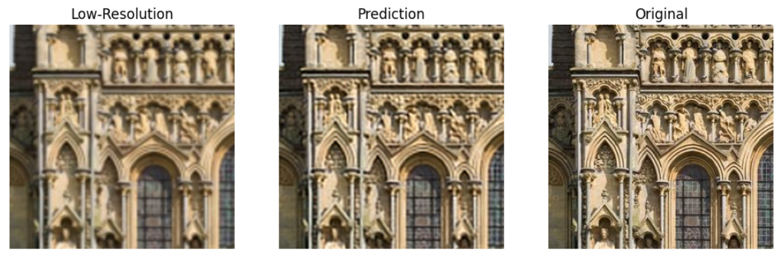
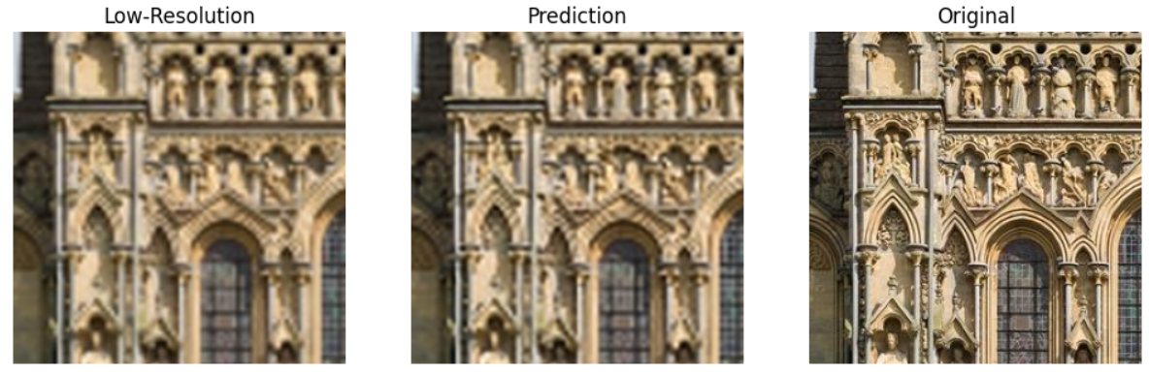
Introducing Structural Similarity Index
Model 3 performance (2x scale factor):
Average PSNR between low resolution images (bicubic interpolation) and high-resolution images: 37.92 dB
Average PSNR between predicted images and high-resolution images: 37.42 dB
Average SSIM between low resolution images (bicubic interpolation) and high-resolution images: 0.8460
Average SSIM between predicted images and high-resolution images: 0.9050
Inflated by easy images
Good gap from baseline
PSNR between LR and HR: 28.69 dB
PSNR between Predicted and HR: 28.92 dB
SSIM between LR and HR: 0.64
SSIM between Predicted and HR: 0.78
Model 4 performance (3x scale factor):
Average PSNR between low resolution images (bicubic interpolation) and high-resolution images: 37.52 dB
Average PSNR between predicted images and high-resolution images: 37.03 dB
Average SSIM between low resolution images (bicubic interpolation) and high-resolution images: 0.8069
Average SSIM between predicted images and high-resolution images: 0.8173
PSNR between LR and HR: 28.54 dB
PSNR between Predicted and HR: 28.56 dB
SSIM between LR and HR: 0.55
SSIM between Predicted and HR: 0.58

Slide 16
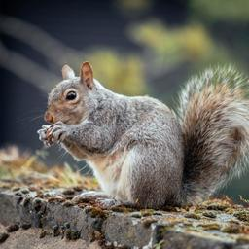

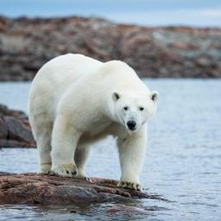
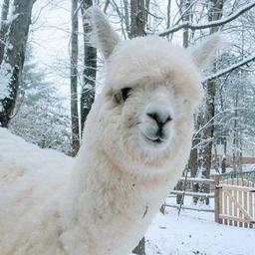
Second dataset and fifth model
Mammals dataset
Hoping that similarity can help the model learn more easily and reach better performance

Slide 17
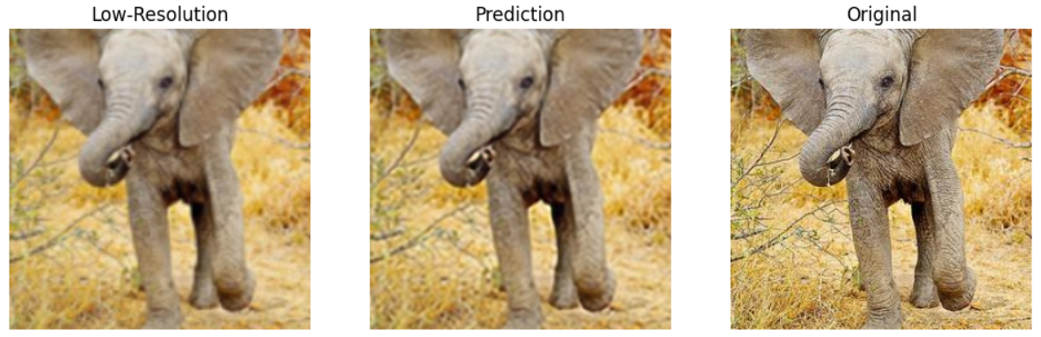
Second dataset and fifth model
Same model as model 3, 256x256 input, 2x scale factor
Average PSNR between low resolution images (bicubic interpolation) and high-resolution images: 31.88 dB
Average PSNR between predicted images and high-resolution images: 31.84 dB
Average SSIM between low resolution images (bicubic interpolation) and high-resolution images: 0.7861
Average SSIM between predicted images and high-resolution images: 0.7948
Disappointing results
Very close to the baseline
Significantly worse than model 3
PSNR between LR and HR: 29.13 dB
PSNR between Predicted and HR: 29.14 dB
SSIM between LR and HR: 0.54
SSIM between Predicted and HR: 0.56
Very small quality improvement probably due to the broad dataset and the unpredictability of certain textures like fur

Slide 18
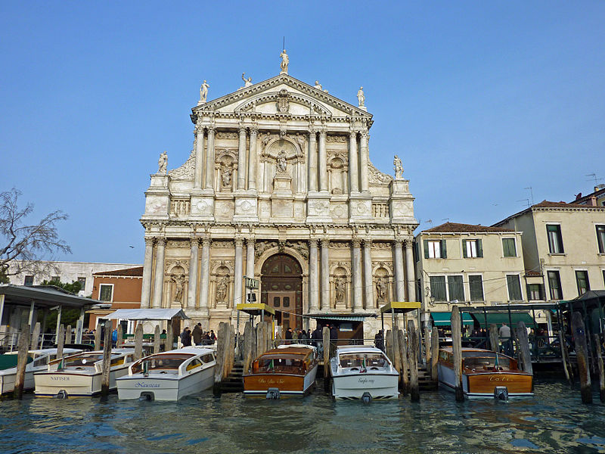
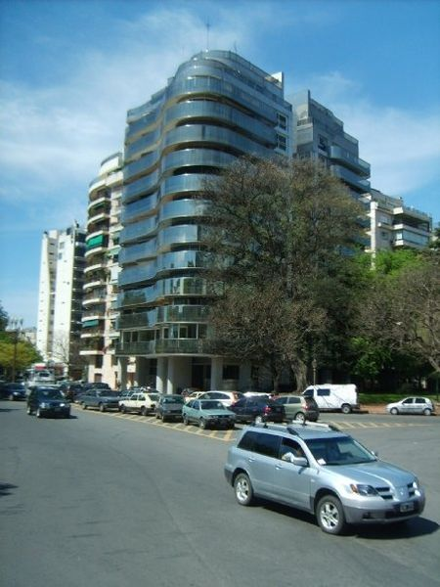
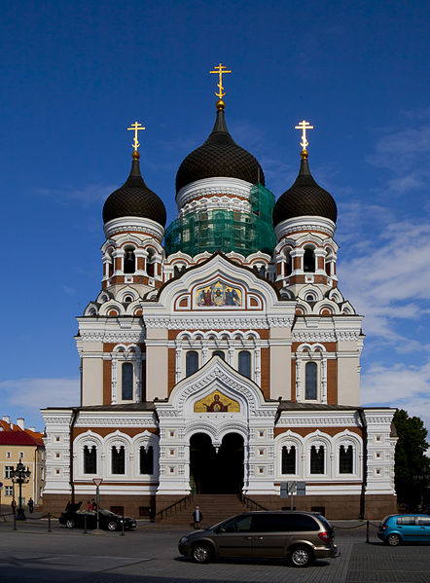
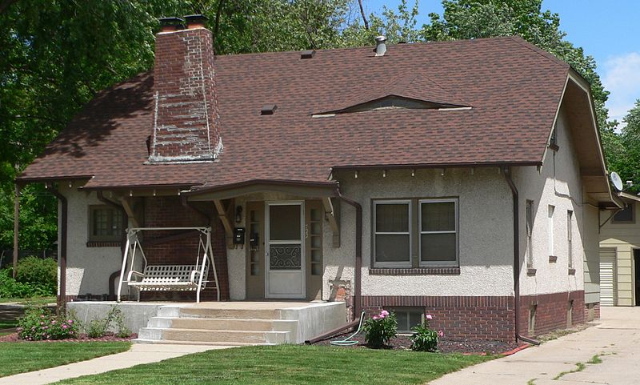
Third dataset and sixth model
Architecture dataset
Different styles of architecture, should share some features like sharp edges

Slide 19
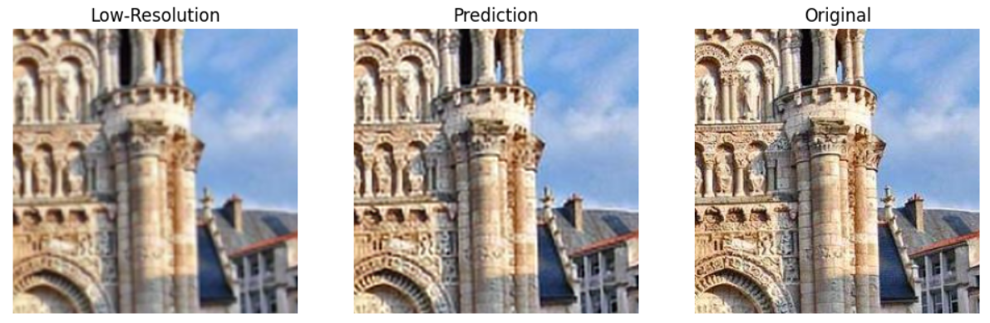
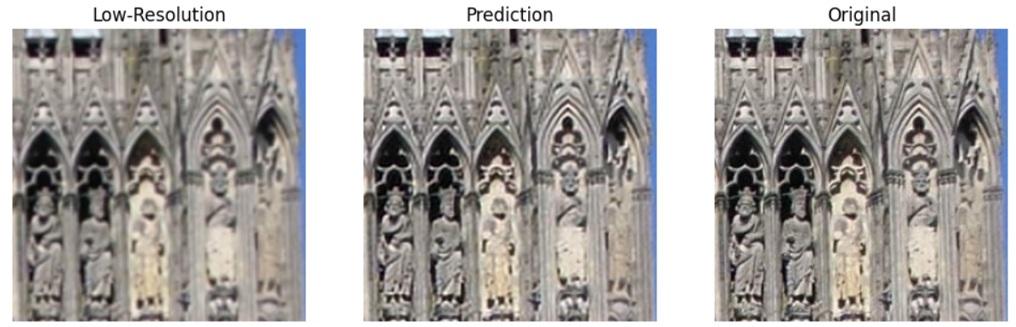
Third dataset and sixth model
Same model as model 3 and 5, 256x256 input, 2x scale factor
Average PSNR between low resolution images (bicubic interpolation) and high-resolution images: 33.96 dB
Average PSNR between predicted images and high-resolution images: 35.92 dB
Average SSIM between low resolution images (bicubic interpolation) and high-resolution images: 0.8554
Average SSIM between predicted images and high-resolution images: 0.9477
Really good results, SSIM close to 1
PSNR between LR and HR: 29.79 dB
PSNR between Predicted and HR: 30.31 dB
SSIM between LR and HR: 0.75
SSIM between Predicted and HR: 0.86
PSNR between LR and HR: 29.40 dB
PSNR between Predicted and HR: 31.61 dB
SSIM between LR and HR: 0.77
SSIM between Predicted and HR: 0.94

Slide 20
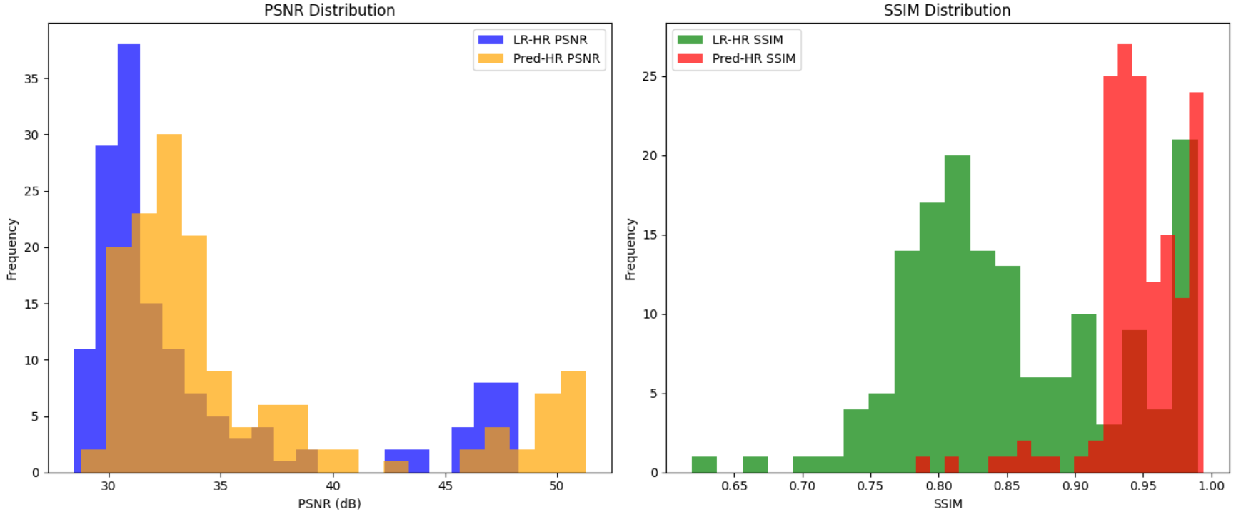
Distribution of quality metrics
Model 6 (previous model, architecture dataset, 256x256 input size, 2x scale factor)

Slide 21
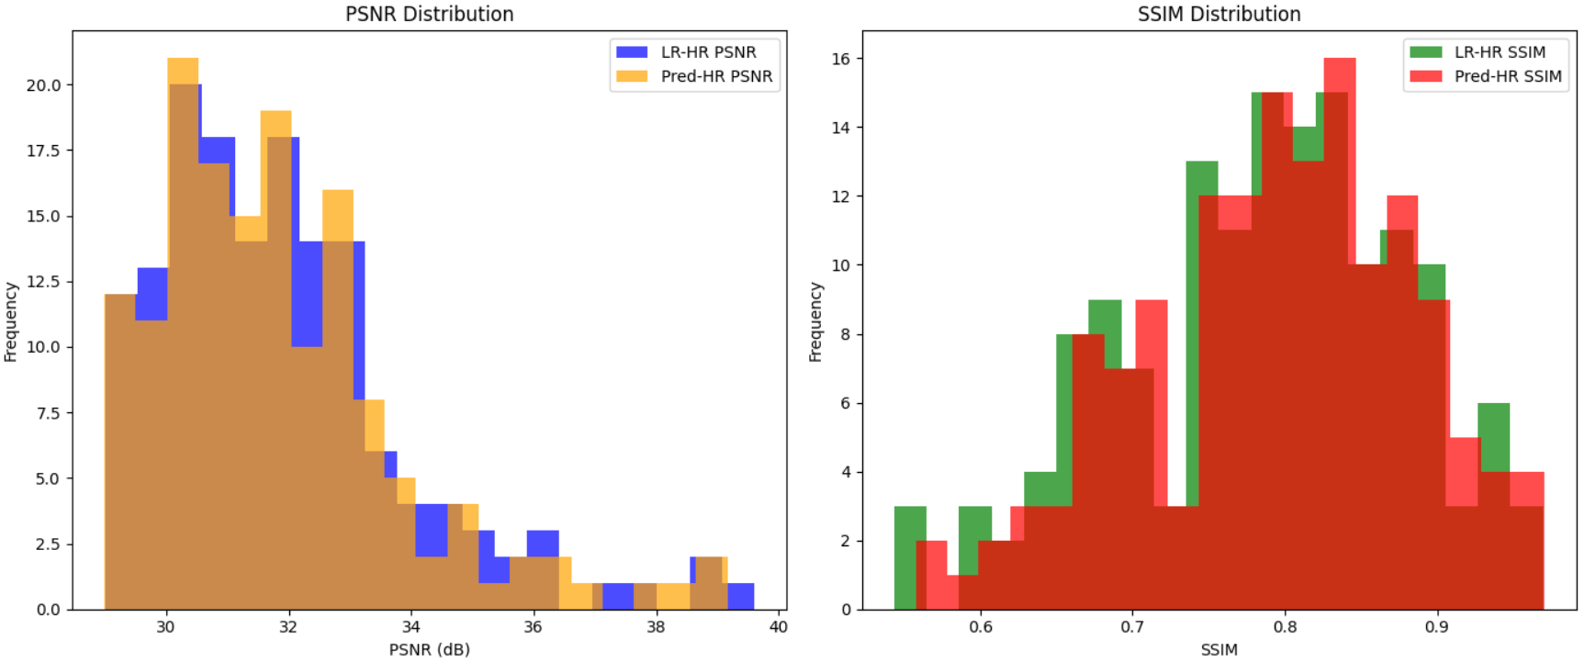
Distribution of quality metrics
Model 5 (mammals dataset, 256x256 input size, 2x scale factor)

Slide 22
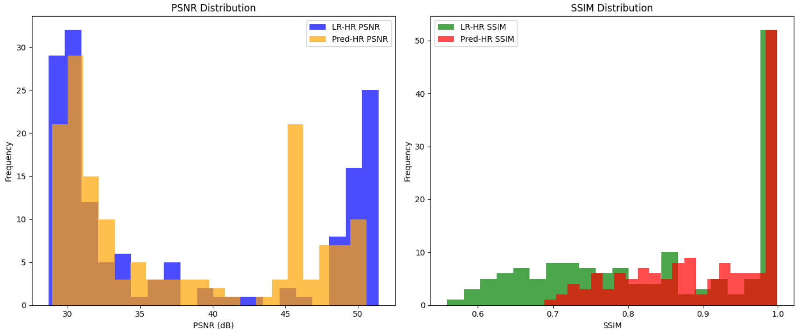
Distribution of quality metrics
Model 3 (general dataset, 256x256 input size, 2x scale factor)

Slide 23
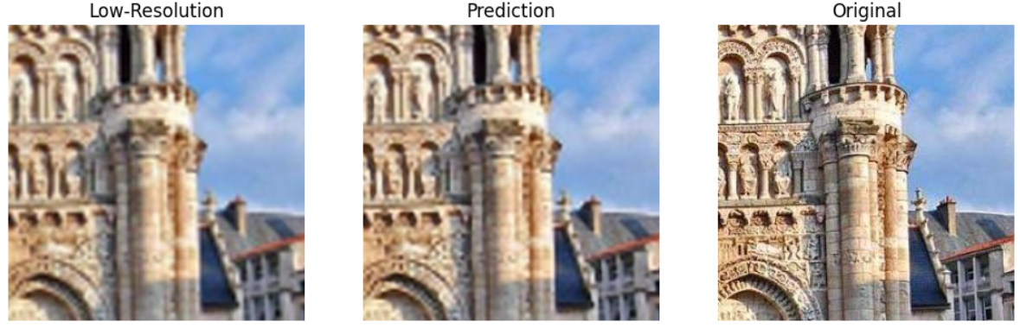
Seventh model
Same as the previous model: third dataset, 256x256 input, but with 3x scale factor
Average PSNR between low resolution images (bicubic interpolation) and high-resolution images: 33.46 dB
Average PSNR between predicted images and high-resolution images: 33.55 dB
Average SSIM between low resolution images (bicubic interpolation) and high-resolution images: 0.8005
Average SSIM between predicted images and high-resolution images: 0.8176
Performance very similar to model 4
The model itself could be the chokepoint
PSNR between LR and HR: 29.66 dB
PSNR between Predicted and HR: 29.71 dB
SSIM between LR and HR: 0.69
SSIM between Predicted and HR: 0.71

Slide 24
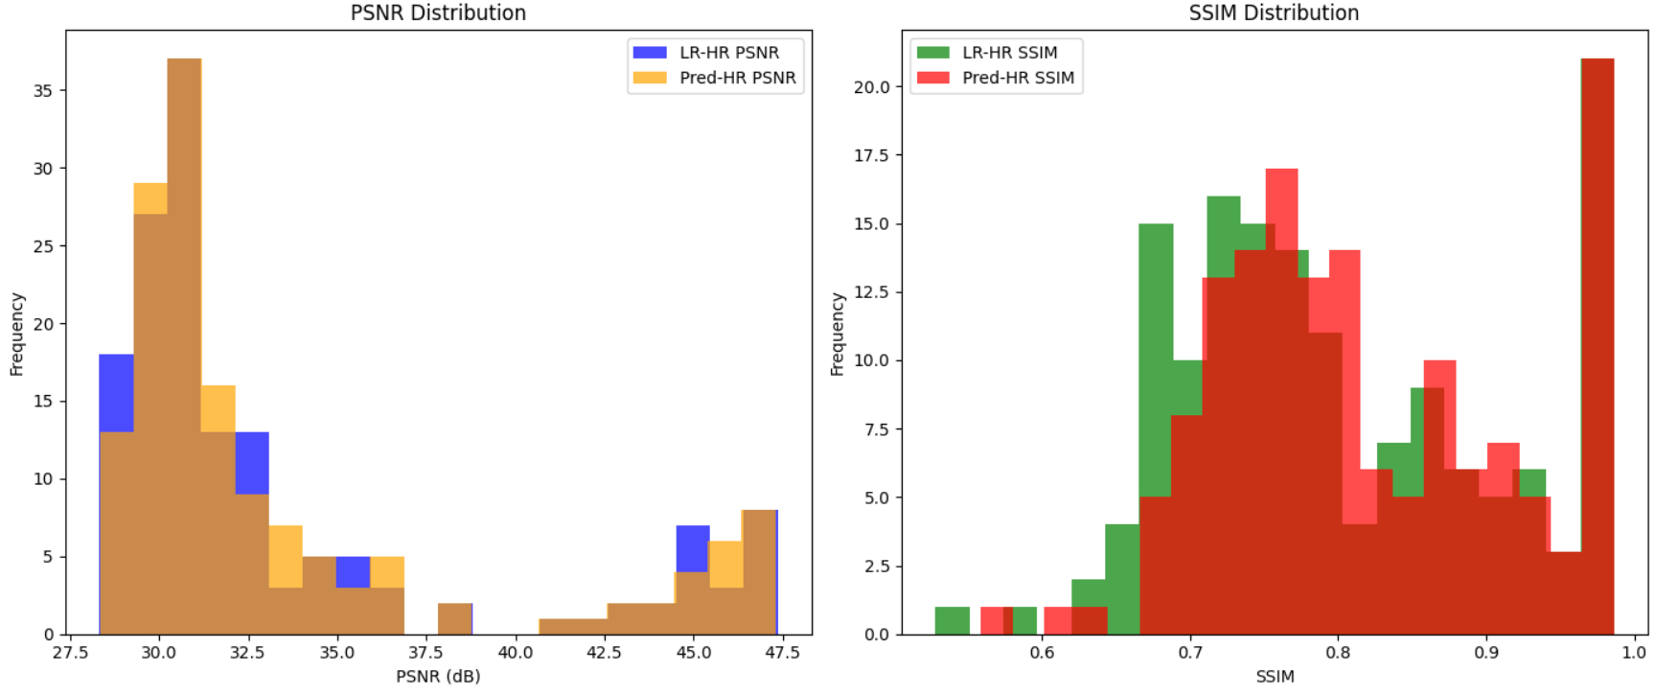
Distribution of quality metrics
Model 7 (architecture dataset, 256x256 input size, 3x scale factor)

Slide 25
Image reconstruction on HighResTestSet

Slide 26
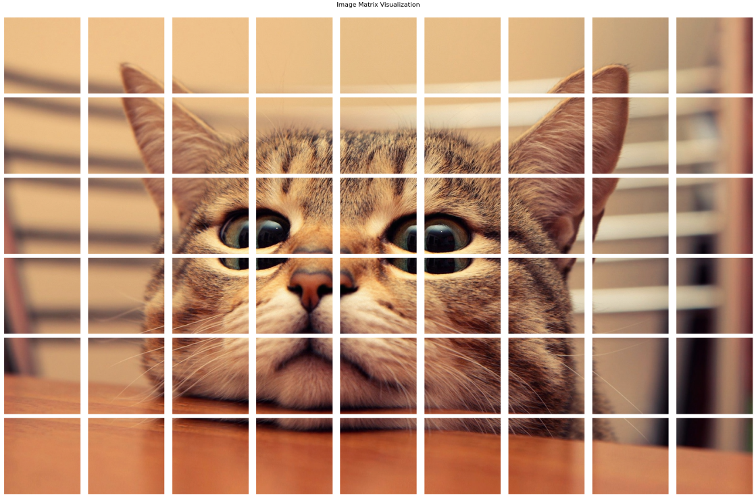
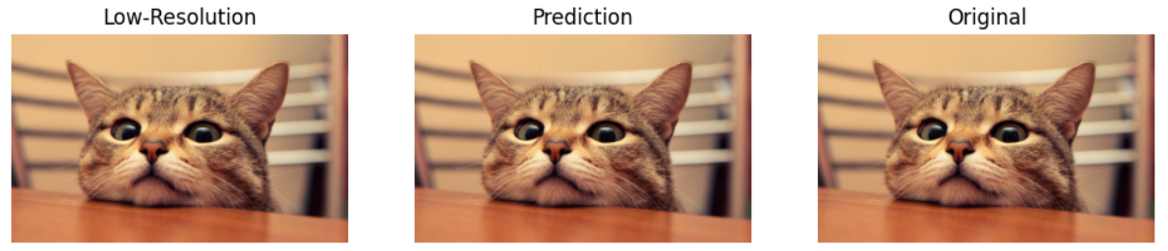
Image reconstruction
The high resolution images are split by the size needed to process each patch with the SRCNN model (considering both input and output sizes)
Each patch is upscaled with the 6th model (2x scale factor)
The patches are stitched together for all three output images (low-resolution upscaled with bicubic interpolation, predicted image, original)
The performance metrics are calculated directly on these resulting images
PSNR between LR and HR: 35.64 dB
PSNR between Predicted and HR: 37.16 dB
SSIM between LR and HR: 0.90 SSIM between Predicted and HR: 0.94

Slide 27
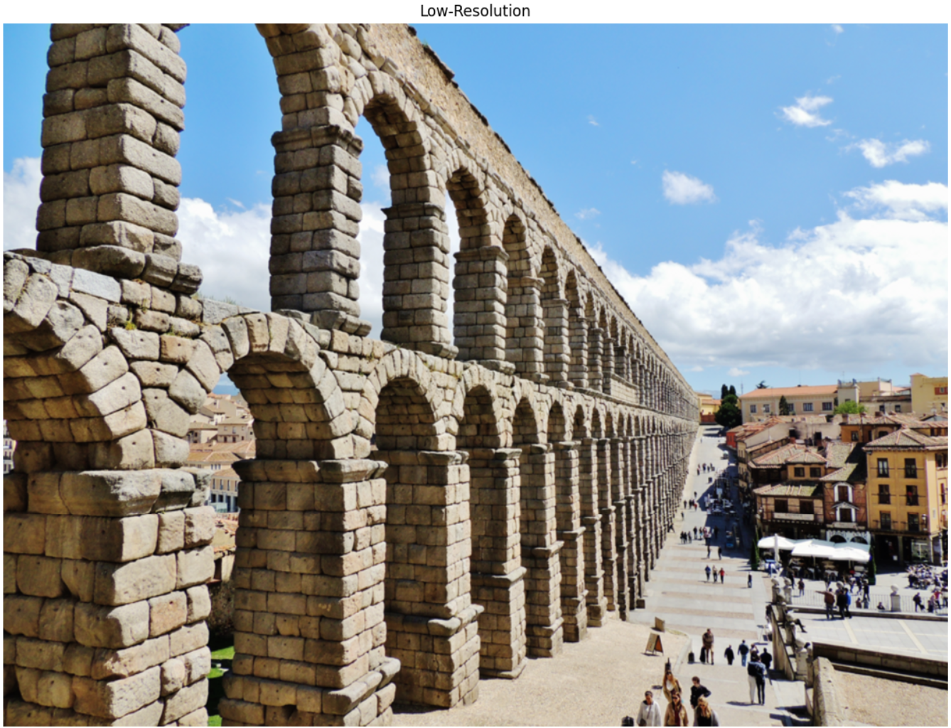
PSNR between LR and HR: 32.22 dB PSNR between Predicted and HR: 32.68 dB SSIM between LR and HR: 0.81 SSIM between Predicted and HR: 0.89

Slide 28

PSNR between LR and HR: 32.22 dB PSNR between Predicted and HR: 32.68 dB SSIM between LR and HR: 0.81 SSIM between Predicted and HR: 0.89

Slide 29

PSNR between LR and HR: 32.22 dB PSNR between Predicted and HR: 32.68 dB SSIM between LR and HR: 0.81 SSIM between Predicted and HR: 0.89

Slide 30
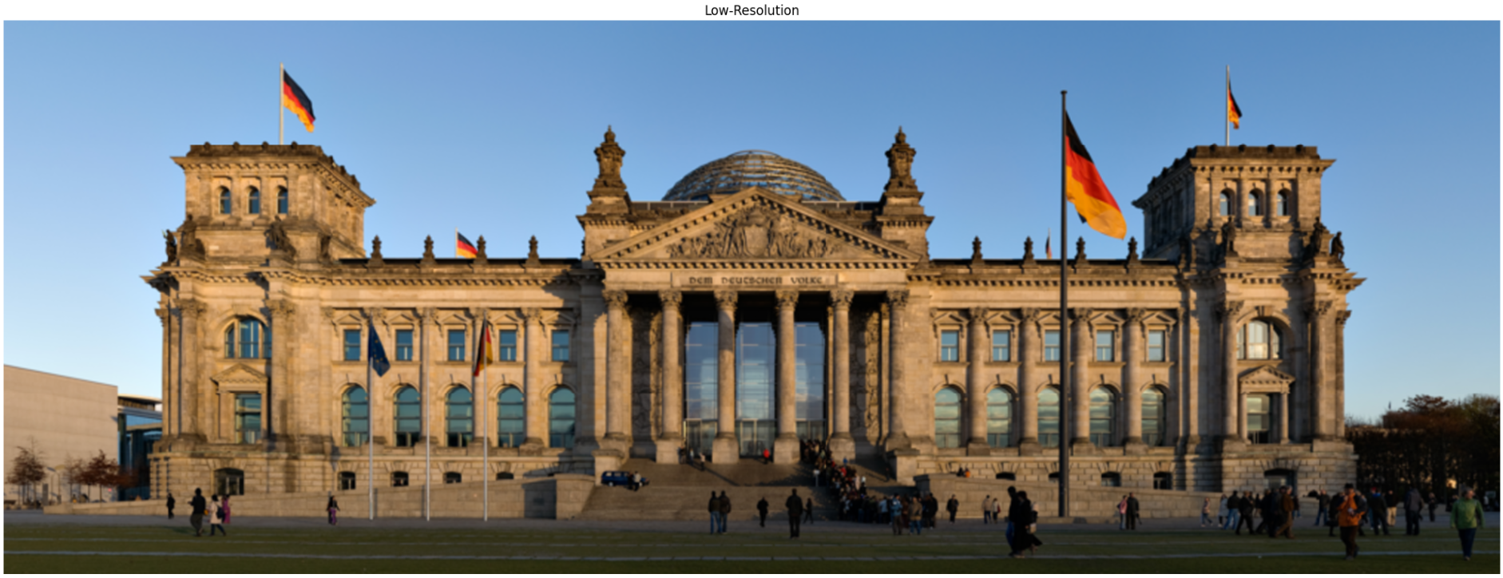
PSNR between LR and HR: 32.99 dB
PSNR between Predicted and HR: 33.54 dB
SSIM between LR and HR: 0.84
SSIM between Predicted and HR: 0.90

Slide 31
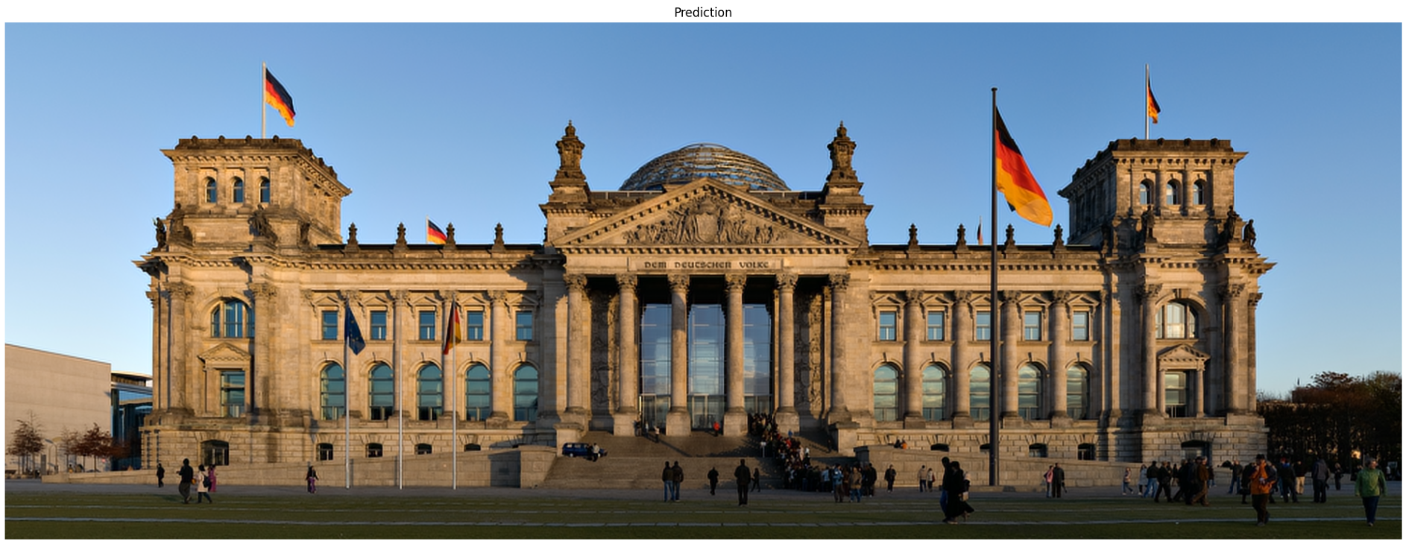
PSNR between LR and HR: 32.99 dB
PSNR between Predicted and HR: 33.54 dB
SSIM between LR and HR: 0.84
SSIM between Predicted and HR: 0.90

Slide 32
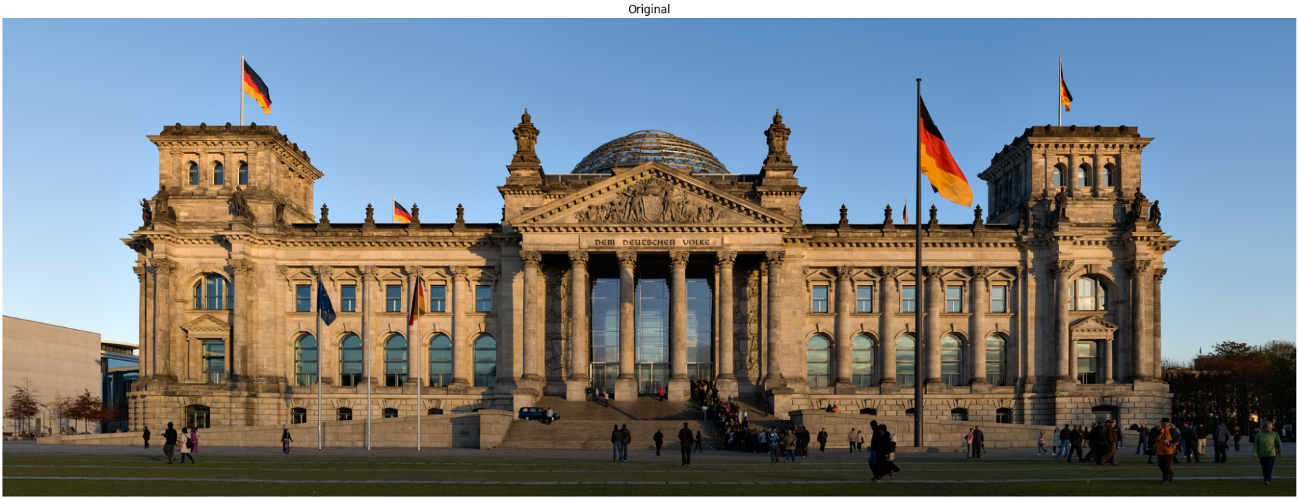
PSNR between LR and HR: 32.99 dB
PSNR between Predicted and HR: 33.54 dB
SSIM between LR and HR: 0.84
SSIM between Predicted and HR: 0.90

Slide 33
Fast Super Resolution Convolutional Neural Network (FSRCNN)

Slide 34
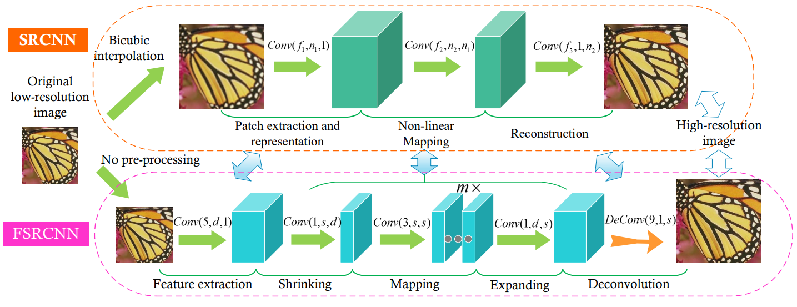
FSRCNN vs SRCNN
Faster execution and better reconstruction
Takes as input the low resolution image without any upscaling needed
Output size bigger than the input size
Uses deconvolution layers to increase the spatial dimension

Slide 35
FSRCNN
Feature extraction layer: extracts shallow features from the input image by applying convolutions (d=56 filters).
Shrinking layer: reduces the dimensionality of the feature maps to reduce computation and model size (s=12 filters).
Mapping layers: perform non-linear transformations in the reduced feature space to learn mappings for super-resolution (s=12 filters for every m=4 maps).
Expanding layer: expands the reduced feature maps back to higher dimensions, before the reconstruction.
Deconvolution layer: upscales the spatial resolution of the feature maps to the desired high-resolution output, based on the chosen scale factor.

Slide 36
First FSRCNN model
Recreates 244x244 images (just like the previous models that took 256x256 input images) with a 2x upscale factor, on the third dataset
Sixth model performance, for comparison:
Average PSNR between low resolution images (bicubic interpolation) and high-resolution images: 33.96 dB
Average PSNR between predicted images and high-resolution images: 35.92 dB
Average SSIM between low resolution images (bicubic interpolation) and high-resolution images: 0.8554
Average SSIM between predicted images and high-resolution images: 0.9477
Execution time: 18.63 seconds
First FSRCNN model:
Average PSNR between low resolution images (bicubic interpolation) and high-resolution images: 34.42 dB
Average PSNR between predicted images and high-resolution images: 34.16 dB
Average SSIM between low resolution images (bicubic interpolation) and high-resolution images: 0.8768
Average SSIM between predicted images and high-resolution images: 0.9409
Execution time: 17.98 seconds
Difficult to compare the speed given the high variability between executions
Lowering the number of filters can help make it faster

Slide 37
Second FSRCNN model
3x upscale factor
Seventh model performance, for comparison:
Average PSNR between low resolution images (bicubic interpolation) and high-resolution images: 33.46 dB
Average PSNR between predicted images and high-resolution images: 33.55 dB
Average SSIM between low resolution images (bicubic interpolation) and high-resolution images: 0.8005
Average SSIM between predicted images and high-resolution images: 0.8176
Second FSRCNN model:
Average PSNR between low resolution images (bicubic interpolation) and high-resolution images: 33.35 dB
Average PSNR between predicted images and high-resolution images: 32.60 dB
Average SSIM between low resolution images (bicubic interpolation) and high-resolution images: 0.7646
Average SSIM between predicted images and high-resolution images: 0.8460
Good improvement from the SRCNN, still not amazing though

Slide 38
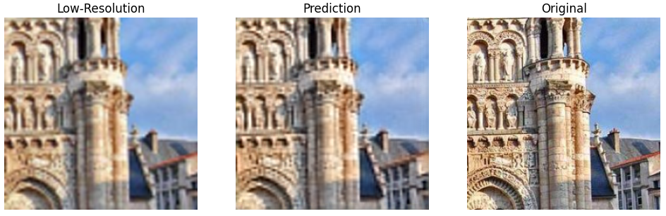
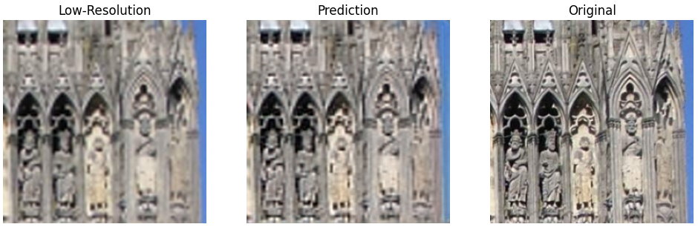
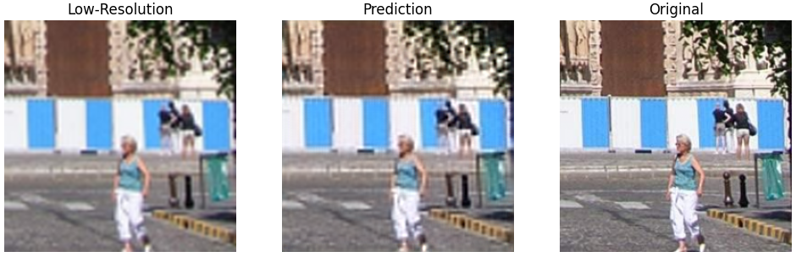
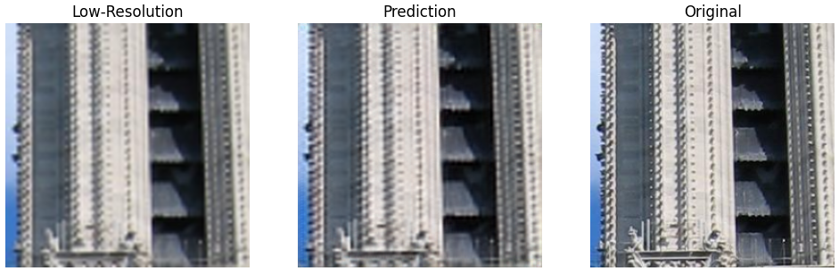
Some improvement is now visible
PSNR between LR and HR: 29.63 dB
PSNR between Predicted and HR: 29.92 dB
SSIM between LR and HR: 0.68
SSIM between Predicted and HR: 0.78
PSNR between LR and HR: 29.03 dB
PSNR between Predicted and HR: 29.48 dB
SSIM between LR and HR: 0.61
SSIM between Predicted and HR: 0.77
PSNR between LR and HR: 30.11 dB
PSNR between Predicted and HR: 30.42 dB
SSIM between LR and HR: 0.71
SSIM between Predicted and HR: 0.80
PSNR between LR and HR: 30.14 dB
PSNR between Predicted and HR: 30.56 dB
SSIM between LR and HR: 0.64
SSIM between Predicted and HR: 0.80

Slide 39
Thanks for Your Attention

